Slide 1
Principles of Carbon Farming

Slide 2
Carbon farming (also known as carbon sequestration) is a system of agricultural management that
helps the land store more carbon and reduce the number of greenhouse gases that it releases into the atmosphere.
Sustainable forest management practices do similar good by minimizing greenhouse gases and accumulating carbon dioxide in wood.
This practice helps the land store carbon, removes greenhouse gases from the atmosphere, and provides benefits to nearby water sources.
Implementing fertilizer reduction strategies, such as applying compost or biochar (charcoal used as a soil additive to improve crop yield), that reduce the number of greenhouse gases tied up in vegetation can also help in cutting emissions

Slide 3
Methods of Carbon Farming
Carbon farming practices are management practices that are known to sequester carbon and/or reduce GHG emissions.
They are many of such practices that have been identified as conservation practices that improve soil health and sequester carbon while producing important co-benefits, including increased soil water holding capacity, hydrological function, biodiversity, and resilience.
Some of the practices for carbon farming suitable to our conditions

Slide 4
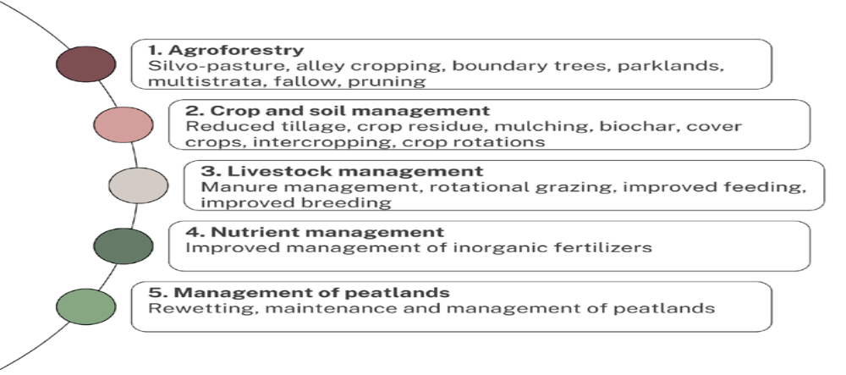
Carbon Farming Practices

Slide 5
Agroforestry
Creation, restoration, and management of agroforestry systems.
In an agroforestry system, woody vegetation, such as trees or shrubs, is integrated with crops and/ or animals (Mcdonald et al., 2021).
Practices include silvo-pasture, alley cropping, and boundary planting (Lamanna et al., 2020).

Slide 6
Crop and Soil management
Crop management practices include cover crops, intercropping, improved crop rotations, and improved varieties.
Soil management practices include reduced tillage, crop residues, mulching, and the addition of biochar (Lamanna et al., 2020).

Slide 7
Livestock Management
Livestock and manure management refer to technologies aimed at reducing enteric methane, and increasing herd and feed efficiency (Mcdonald et al., 2021).
Grassland management is included in this category.
Practices include manure management (from the collection, through storage and treatment up to application), improved feeding, improved breeding as well as rotational grazing (Lamanna et al., 2020).

Slide 8
Nutrient Management
Nutrient management on croplands and grasslands includes improved nutrient planning, timing, and application of fertilizers as well as reductions in fertilizers (Mcdonald et al., 2021).
To avoid overlaps with other categories, this category focuses only on inorganic fertilizers and leaves out organic fertilizers, which are included under crop and soil management practices as well as livestock management.

Slide 9
Management of Peatlands
Management of peatlands includes peatland rewetting, maintenance, and management (Mcdonald et al., 2021).

Slide 10
The benefits of soil carbon farming
Soil carbon farming is gaining traction as an effective way to improve soil health, reduce risk for businesses, and mitigate climate change.
Through practices such as cover crops, no-till systems, time- controlled grazing and composting, the process of increasing organic matter in soils generates a range of benefits including improved water quality; increased resilience during pests or drought conditions; and sequestration of atmospheric carbon dioxide into land.

Slide 11
The benefits of soil carbon farming
As organisations search for viable solutions that will move us towards sustainability goals – all while protecting food security–soil carbon farming presents a promising pathway forward with co-benefits along the way

Slide 12
Soil carbon farming benefits for the environment.
Soil carbon farming provides a vital environmental service:
the ability to pull CO2 out of our atmosphere and make use of it in beneficial ways.
By sequestering atmospheric CO2, we can not only reduce global greenhouse gas levels, but also support soil health with increased water-holding capacity and greater drought resistance.

Slide 13
Soil carbon farming benefits for producers
Implementing soil carbon farming has several benefits for producers, which range from increasing soil fertility, to improving soil quality and minimising soil erosion.
Additionally, soil carbon farming offers producers the potential of earning Carbon Credit Units, diversifying income sources, and reducing business risk.
However, modern soil carbon farming is not without its challenges; accurate measurement of soil carbon levels is key in order to realise the true benefits from regenerative agriculture practices.

Slide 14
Methods of Carbon Farming
Carbon farming practices are management practices that are known to sequester carbon and/or reduce GHG emissions.
Resource Conservation Service (NRCS) as conservation practices that improve soil health and sequester carbon while producing important
co-benefits, including increased soil water holding capacity, hydrological function, biodiversity, and resilience.
Some of the practices for carbon farming suitable to Indian conditions are:

Slide 15
Forest Management
Healthy forests absorb and hold carbon dioxide emissions produced from other sources and are an important source of greenhouse gas (GHG) sequestration.
Improved forest management focuses on long-term, sustainable practices to ensure that forests continue to remove CO2 from the atmosphere since deforestation accounts for between 15 and 20 percent of the global increase n GHG levels.
Activities include thinning out, selective harvest, regeneration and planting, and fertilization to enable productive and sustainable forest growth.

Slide 16
Grasslands Conservation
Similar to forestry, native grasses and other vegetation provide a natural source of greenhouse gas (GHG) absorption and sequestration.
Carbon offsets from this category focus on maintaining native plant life through permanent land conservation and avoided conversion for commercial developent or intensive agriculture.

Slide 17
Renewable Energy Production
Renewable energy facilities, such as wind or solar, generate carbon offsets by displacing fossil fuel-based electricity production sources within the power grid.
The carbon offsets derived from a certified third-party project generates the carbon credit, which is owned by the entity that develops the project

Slide 18
Reduced fertilizer application
Chemical inputs reduce the capacity of soils to sequester carbon and can be wasteful when applied in excess.
With prices going sky-high, manufacturing inorganic fertilizers also release a lot of greenhouse gas emissions.
Decreased chemical fertilizer application is a cost-reducing way to optimize the nutrient application for crops and improve soil health.

Slide 19
Reduced tillage
Frequent and heavy tilling increases the rate of carbon dioxide released from the soil.
In the process, it also breaks up soil structure which can lead to erosion and less productive croplands.
Regenerative tillage, which is done at minimum or no-tillage at all, preserves soil quality and carbon that has benefits to crop yield.

Slide 20
Improved residue management
Another soil-protecting strategy in farming is to leave crop residue in the fields.
Covering the soil with mulch, or crop residue materials like straws, enhances soil moisture and fertility while allowing the organic material to interact with microorganisms for healthier soil composition.

Slide 21
Eliminating bare fallows
Leaving cultivated land to lie idle for a season or more leaves the soil exposed without any protection from heat, wind, rain, and weeds where soil carbon can escape more readily.
Instead, sowing nitrogen-fixing crops like clover can help keep the carbon in the ground as well as improve the soils nitrogen content for the next crop.

Slide 22
Increasing the production of cover crops
One of the most recommended carbon farming methods is to introduce cover cropping.
These kinds of crops are grown precisely to protect the soil, which is different from the primary crop usually cultivated on the farm.
Cover crops reduce surface disturbance and work to help capture nutrients to build soil fertility and soil organic carbon.

Slide 23
Sowing companion crops
Companion planting increases plant diversity by growing 2 or more crops close together to benefit not just the crops but also the soil.
Knowledge of complementary crops is necessary to maximize the growth and production of crops.
For example, one crop is sown to protect the primary crop from pests and insects.

Slide 24
Agroforestry
Farming with the intentional integration of trees with agriculture is known as agroforestry.
Agroforestry practices can help mitigate emissions and store carbon in both soils and trees.
Not only does agroforestry provide above-ground benefits in the field but it also provides crucial below-ground benefits.
It does this while also enhancing farm productivity, increasing soil protection, improving air and water quality; providing wildlife habitat, and introducing diversified income.

Slide 25
Improved water management
Excess water washes away nutrients and can even lead to erosion.
Managing irrigation properly by watering at appropriate times, given at the right rates, and at the most optimum depth and distance from the crops can optimize crop growth and minimize resource waste.

